Slide 1
Is there a link between obesity and depression
The story of the mesolimbic dopamine system, decision making, and depression
A presentation by Tyler Bradley

Slide 2
What is depression?
DSM-V criteria for Major Depressive Disorder (MDD)
Depressed mood or a loss of interest or pleasure in daily activities for more than two weeks
Mood represents a change from the person's baseline
Impaired function: social, occupational, educational
DSM-V proposed that anxiety is often comorbid with MDD
Notes:
DSM-V is the The Diagnostic and Statistical Manual of Mental Disorders, Fifth Edition
It is the 2013 update to the American Psychiatric Association's classification and diagnostic tool
Proves useful to help categorize and diagnose mental disorders

Slide 4
Additional Criteria
Specific symptoms, at least 5 of these 9, present nearly every day
Depressed mood or irritable most of the day, nearly every day, as indicated by either subjective report
Decreased interest or pleasure in most activities, most of each day
Significant weight change (5%) or change in appetite
Change in sleep: Insomnia or hypersomnia
Change in activity: Psychomotor agitation or retardation
Fatigue or loss of energy
Guilt/worthlessness: Feelings of worthlessness or excessive or inappropriate guilt
Concentration: diminished ability to think or concentrate, or more indecisiveness
Suicidality: Thoughts of death or suicide, or has suicide plan
Notes:
These additional criteria are helpful diagnostic tools when dealing with humans
However it becomes apparent that a majority of the criteria would be impossible/extremely difficult to quantify in animal models

Slide 5
Depression in Animals
Tests are often used to see if an animal exhibits depressive behavior
Anxiety
Anhedonia
Perceived despair
Decreased interest in pleasurable tasks/items
Sweet food/drink, sex, exercise
Decreased social aptitude
Irritability, social regression
Disturbed sleep

Slide 6
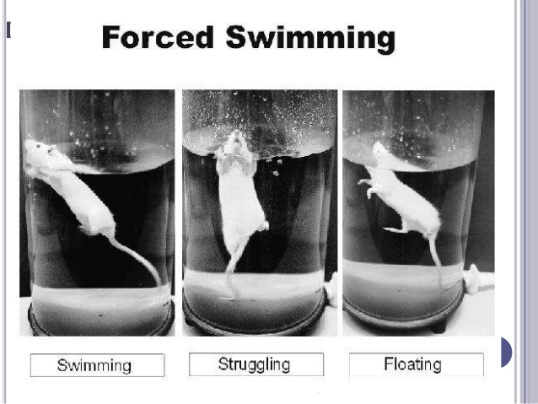
Tests of Depressive Behavior
Forced Swim Test
Sucrose Preference Test
Tail Suspension Test
Elevated Plus Maze
Open Field Test
Notes:
The FST and TST measure the animal’s perceived struggling. Less time struggling is indicative of despair (a depressive behavior)
Elevated Plus Maze- Animals are in a + shaped maze with two open and two enclosed arms for 5 min sessions
The time spent on open arms and the number of crosses into open arms were measured
Open Field Test- Measured animal locomotion in confined area
Sucrose Preference Test-

Slide 7
What causes depression?
Theories on the mechanism
Monoamine (5-HT) Deficiency
Neurotropic (BDNF) Links
Neuroinflammation
Chronic Social Stress
Other neurological influences
Cholinergic and Dopaminergic mechanisms
Notes:
Most likely a combination of several of the proposed mechanisms

Slide 8
Where should we be looking?
Pre-frontal cortex
Involved in emotional processing and regulation
Dysfunction of this process may be involved in the etiology of depression
Areas of the prefrontal cortex are part of a network of regions including dorsal and pregenual cingulate, bilateral middle frontal gyrus, insula and superior temporal gyrus that appear to be hypoactive in depressed patients

Slide 9
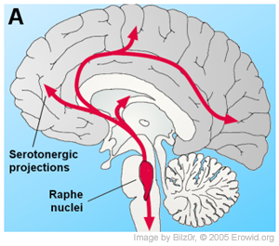
Where should we be looking?
Raphe Nuclei
The raphe nuclei are a moderate-size cluster of nuclei found in the brain stem
Their main function is to release serotonin to the rest of the brain
Selective serotonin reuptake inhibitor (SSRI) antidepressants are believed to act in these nuclei, as well as at their targets

Slide 10
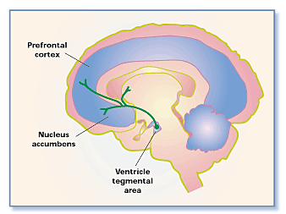
Where should we be looking?
Areas involved in the mesolimbic dopamine pathway
Ventral Tegmental Area
Nucleus Accumbens
Dopaminergic pathway- “Reward” Pathway
Heavily implicated in addiction
Known to be important for incentive salience & motivation
Notes:
We will return to the mesolimbic dopamine system shortly
VTA
PFC
NAc

Slide 11
Decision Making
Decision making is a process that can be broken down into various components
Perception
Consideration
Choice
Outcome

Slide 12
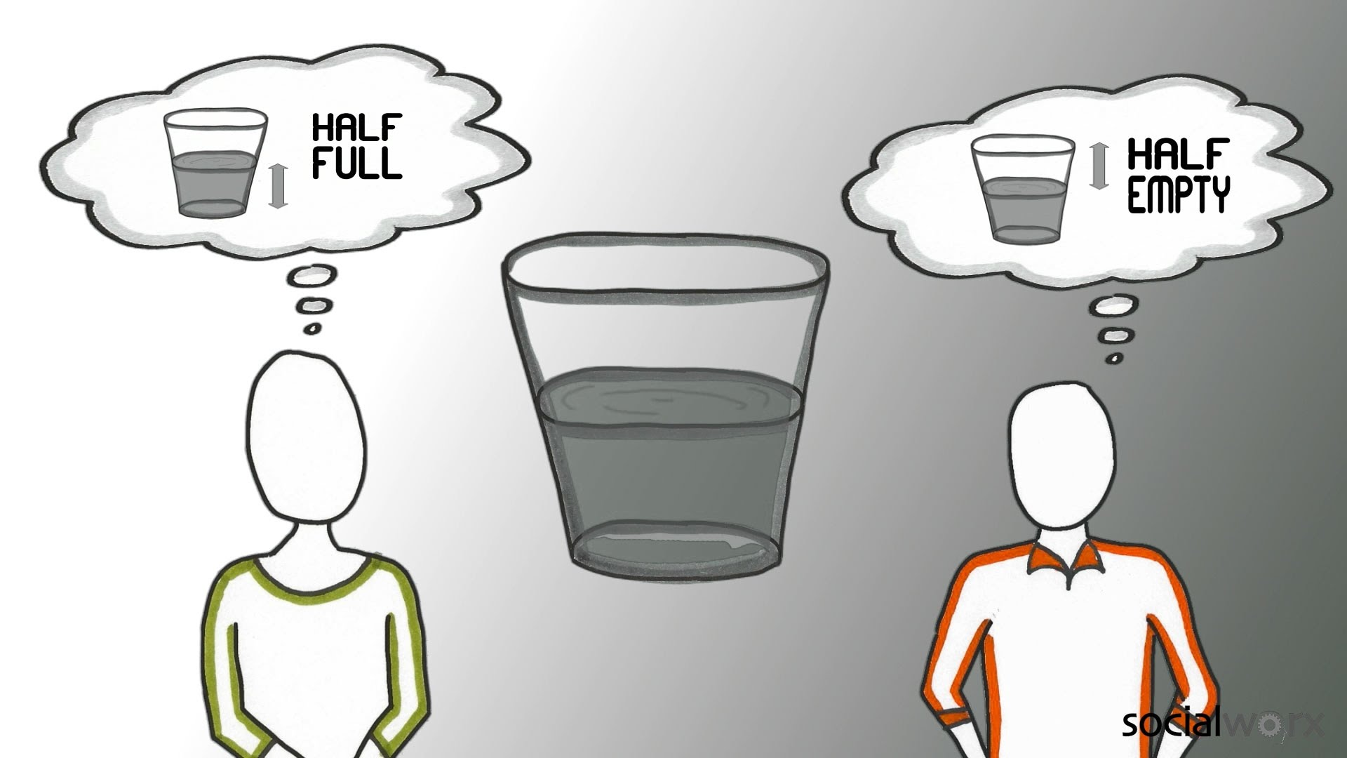
Perception
Interaction with actor
Could be stressor

Slide 13
Consideration
Deliberation
Analyze risks/rewards
May involve past experiences
Emotions
Preference plays a role
Habituation can be implicated

Slide 14
Choice
Involves value associated
Is potential risk worth potential reward
Weighing outcomes
Evaluating possibilities

Slide 15
Outcome
Response
Or lack of response
Can involve motor component
Results in commitment
Depending on results

Slide 16
Influences on decision making
Mesolimbic dopamine system
Reward circuit
Dopamine and cholinergic tone modulate
VTA, NAc
Prefrontal Cortex
Value components
Amygdala
Emotional components

Slide 17
How might decisions be altered during depression?
Impulsivity
Reward circuitry
Anhedonia
Reduced pleasure seeking behavior
Stress vulnerability
Commitment

Slide 18
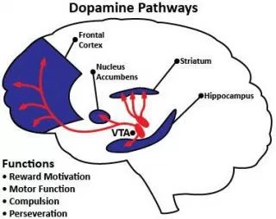
A possible connection
Mesolimbic dopamine system

Slide 19
Chapter 1- Ventral tegmental area muscarinic receptors modulate depression and anxiety-related behaviors in rats
Keri M. Small, Eric Nunes, Shannon Hughley, Nii A. Addy
Notes:
Cholinergic and dopamineric mechanisms within the mesolimbic dopamine system are suggested to play a role in the manifestation of depression and anxiety-related disorders.
Cholinergic mechanisms in the ventral tegmental area (VTA) highly regulate dopamine activity

Slide 20
Background
Sought out to examine how Ach in the VTA affects depressive behaviors
Dysfunction of mesolimbic dopamine system is associated with Major Depressive Disorder and Generalized Anxiety Disorder
But what is regulating?
Cholinergic system is known to modulate depression symptomology

Slide 21
Background
Cholinergic activity in dopaminergic brain regions implicated in depressive behaviors through previous research
Nucleus Accumbens (NAc)
Prefrontal Cortex (PFC)
Role of Ventral Tegmental Area needs to be examined
VTA contains cell bodies from the mesolimbic dopamine system

Slide 22
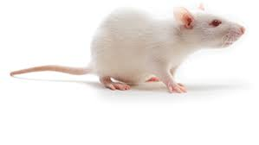
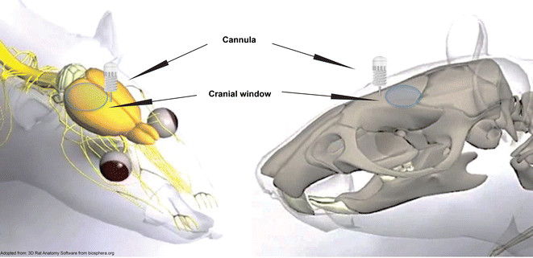
Methods
Adult male Sprague Dawley rats were used
Underwent surgery
Anesthetized with ketamine
Bilateral cannula intra-cranially implanted
7 day recovery time after surgery

Slide 23
Methods
Bilateral internal cannula placed 1 mm about the VTA
Drugs delivered through cannula
Via micro-infusion pump
Physostigmine and Pilocarpine were the drugs used
Physostigmine- An AChesterase inhibitor
Doses of either 0,1, or 2 µg
Pilocarpine- A selective muscarinic Ach receptor agonist (mAChR)
Dosees of either 0, 3, or 30 µg
VTA drug infusion performed immediately prior to experiments

Slide 24
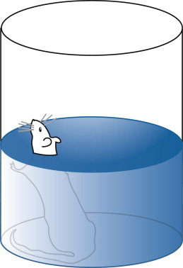
Methods
Forced Swim Test
Experimentally naïve rats placed in water tank post-infusion
Immobility was measured
Defined by lack of back paw paddling
Suggestive of despair

Slide 25
Methods
Sucrose Preference Test
Experimentally naïve rats placed in normal cage
Given access to standard chow and water
Test day- deprived of water for 4 hours
Then given access to two bottles for 1 hour
One with water
One with 1% sucrose solution
Consumption was measured and recorded

Slide 26
Elevated Plus Maze
Experimentally naïve rats placed in maze
+ shaped and elevated 40-70 cm
2 open arms and 2 enclosed arms
In maze for a 5 minute session
Time spent in open arms and number of crosses recorded

Slide 27
Physostigmine Results
↑Immobility time
↓ Time on open arms
Notes:
Effect of intra-VTA physostigmine (0, 1, 2 μg/side) on FST, EPM, and locomotor activity.
Physostigmine increased immobility time in the FST (A),
decreased time spent on open arms of EPM (B),
and had no effect on locomotor activity (C).
Data are expressed as mean ± S.E.M.; (* p < 0.05, ** p < 0.01).

Slide 28
Physostigmine Results
↓ Sucrose Consumed
Notes:
Effect of intra-VTA physostigmine (0, 1, 2 μg/side) on SPT.
Physostigmine decreased sucrose preference.
Data expressed as mean ± S.E.M.; (* p < 0.05).

Slide 29
Pilocarpine Results
Notes:
Effect of intra-VTA pilocarpine (0, 3, 30 μg/side) on FST, EPM, and locomotor activity.
Pilocarpine increased immobility time in the FST (A),
Decreased time spent on the open arms of EPM (B),
Had no effect on locomotor activity (C).
Data expressed as mean ± S.E.M.; (* p < 0.05, ** p < 0.01, *** p < 0.001).

Slide 30
Results
Enhanced cholinergic tone in VTA→
Promoted pro-depressive behavior, anxiogenic behavior, and anhedonia
Via Physostigmine
Selective activation of VTA mAChRs→
Promoted pro-depressive behavior, anxiogenic behavior
Via Pilocarpine

Slide 31
Discussion
Cholinergic mechanisms in mesolimbic dopamine system regulate phasic dopamine activity
In VTA to NAc pathway
Enhanced ACh in NAc is associated with pro-depressive behavior
Conversely, decreased ACh in NAc is associated with anti-depressive effects
Known via mechanism of fluoxetine

Slide 32
Discussion
VTA mAChR activation faciliates mesolimbic dopamine burst firing patterns→
Dopamine release in NAc
Promotes pro-depressive behavior
Suggests that VTA modulates dopamine activity in depression
VTA mAChR blockade decreases mesolimbic dopamine burst firing patterns
Less phasic dopamine release
Promotes anti-depressant like effects

Slide 33
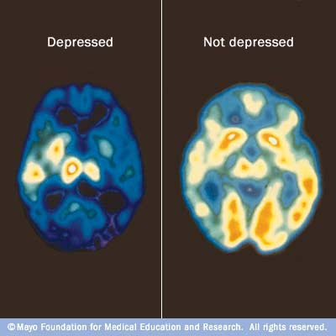
Discussion
Additional research on how VTA hyperactivity is linked with general anxiety disorder
Possibly via downstream Extracellular Regulated Signaling Kinases (ERK)

Slide 34
Conclusion
The mesolimbic dopamine system has a role in modulating depressive behaviors
As well as anxiogenic behaviors
Enhanced cholinergic tone in VTA→ Promoted pro-depressive behavior
Selective activation of VTA mAChRs→ Promoted pro-depressive behavior, anxiogenic behavior
Downstream effects on the NAc affect behavior as well
Via cholinergic mechanisms

Slide 35
Chapter 2- An obesogenic refined low-fat diet disrupts attentional and behavioral control processes in a vigilance task in rats
Aaron P. Blaisdell, Traci Biedermann, Eric Sosa, Ava Abuchaei, Neveen Youssef

Slide 36
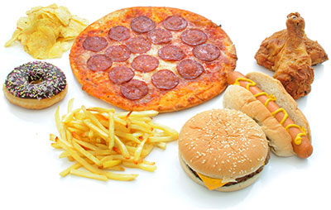
Background
Diets consisting of refined foods (REF) have been associated with poor physical and mental health
Obesity, diabetes, depression, ADHD
Impairments in concentration, impulsivity have been documented

Slide 37
Background
Conditions may be linked to dysregulation of mesolimbic dopamine system
Chronic intake during early development associated with cognitive problems in adulthood
REF foods may be deficient in key nutrients needed for brain development
Western diets are unusually high in refined food products

Slide 38
Background
Degree of refinement is believed to be more important than macronutrient content
Ratio of proteins to carbs to fats
Diet quality may be a critical factor to health
In regards to level of refinement

Slide 39
Background
Diet Variance
Refined diet- REF
Primarily casein and L-Cysteine as protein source
Primarily sucrose, corn starch, and maltodextrin as carbohydrate source
Primarily soybean oil and lard as fat source
Control (non-refined) diet- CON
Primarily corn meal, beet meal, soybean meal, fish meal, oats, yeast, cane molasses
All products with little to no processing or refinement

Slide 40
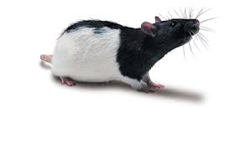
Methods
Female Long Evans rats were used for the study
Each rat received 25 g of standard chow daily
Body weights were recorded every other day
All rats were fed the CON diet until 2 months prior to when vigilance task was performed
Body composition was analyzed via echo MRI twice
Initially when all rats were fed CON diet
Second scan was 41 days after diet switch

Slide 42
Methods
Rats were subjected to a multi-phase training schedule prior to vigilance task
Magazine training- Sucrose delivered periodically in a cup to train rats to approach and drink from cup
Lever-pressing shaping- Rats were trained to approach and press operant levels to access sucrose solution
Conducted on a continuous reinforcement schedule
Lever-light contingency training-Levers were inserted on an alternating schedule with a light above. Pressing a lit lever resulted in sucrose delivery
Two-choice visual discrimination task- Rat nose placement in food cup initiated trial. Two levers, one lit, were inserted for 60 seconds. If a lit lever was pressed, sucrose was available for only 10 seconds

Slide 43
Vigilance Task
Variation of two-choice visual discrimination procedure with two modifications
Variable delays between trial onset and light onset
Either 0, 3, 6, or 12 seconds
The duration of light illumination was changed to 1 second
A correct response was reinforced
Incorrect response (3 types) led to trial ending without reinforcement
Premature response- Rat pressed level prior to light
Choice error- Rat pressed wrong level during light
Omission error- Rat did not press lever

Slide 44
Vigilance Task
Notes:
Left panels: Schematic of front panel of the rat chamber equipped with two lights, each above one of two levers. One lever to the left, the other to the right of the food cup. The top panel shows the outcome of pressing a lever prior to light onset. The middle panel shows two possible outcomes with a lever press within 6-s after light onset. The lower panel shows the outcome of failing to press the lever within 6-s after light onset.
Right panel: Diagram of trial structure. Each trial began with a nose poke into the food cup, which caused the levers to insert into the chamber. One of the two lights would illuminate for 1-s duration, either immediately with lever insertion, or following a delay of 3, 6, or 12 s. A trial ended when a lever was pressed within 6 s of light onset, or 6 s after light onset if no lever press was made.

Slide 45
Results
Notes:
Mean (& 95% CI) change in weight (top left) fat mass (top right), lean mass (bottom left), and adiposity (bottom right) in the CON and REF rats before and 2 months following consumption of the respective diets. Prior to the REF diet, all rats were on the CON diet.

Slide 46
Results
Notes:
Mean (& 95% CI) percent correct responses (top left), choice errors (top right), premature responses (bottom left), and omissions (bottom right) in rats on the REF and CON diets across 5-session blocks of training on the Vigilance task.
Control rats- Higher % correct, lower choice errors over time, lower premature response %, Lower omission %

Slide 47
Results
Notes:
Mean (& 95% CI) percentage of correct responses (top left), Choice errors (top right), Premature responses (bottom left), and Omissions (bottom right) in rats on the REF and CON diets as a function of light delay during the last 10 sessions of the Vigilance task.
Control rats- did better overall
Bottom right significant- Indicative of loss of attention (Omission %)

Slide 48
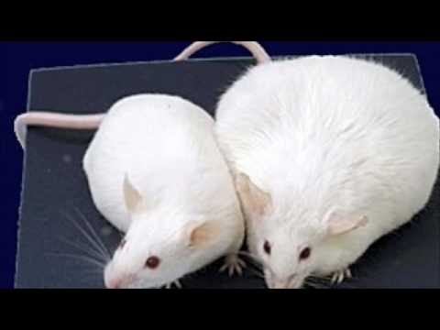
Results
Weight and Body Composition
REF rats gained significantly more weight
REF rats accumulated more fat mass
Difference likely due to increased energy content of REF food
Higher energy density in REF food

Slide 49
Results
Vigilance task acquisition
Main effect of diet on percent correct
CON had a faster increase in accuracy and a decrease in premature responses
Vigilance task delay analysis
Performance differences changed with increased delays
Deficits in sustained attention and behavioral control in REF rats
REF rats showed increased premature responses and omissions when there was an increased delay

Slide 50
Discussion
Consuming a highly refined diet resulted in obesity and cognitive impairments
Relative to CON rats
Results suggest that REF rats were more impulsive
Increased premature response %
Results suggest that REF rats had greater lapses in attention → difficulty staying focused on one task
Increased omission %

Slide 51
Discussion
Increased omission %
Could be due to PFC dysfunction due to obesity or REF diet
PFC responsible for attentional processes
Diet differences could be implicated
REF diet had much higher sugar (sucrose) content
High sugar intake linked with cognitive impairments
REF diet very low in poly-unsaturated fats (n3-FA)
Deficiencies in n3-FA linked with ADHD symptomology

Slide 52
Discussion
Potentially affected brain mechanisms
Prefrontal cortex
Sustained attention, behavioral inhibition
Connections with basal ganglia, hippocampus, and thalamus
Frontal circuit modulated by cholinergic signaling

Slide 53
Discussion
Cholinergic deficiencies in childhood linked to trouble with sustained attention
Treatment with nAChR agonist mitigates deterioration of sustained attention
Suggests that transient ACh activity mediate cue detection
Mediates shift from state of perceptual attention to state of cue evoked activation

Slide 54
Discussion
Enhanced cognitive control in sustained attention tasks in rats has been shown to involve mesolimbic dopamine projections to the PFC
ACh spiking in frontal cortex→ maintain sensory input and planned response
Long term consumption of REF diets in rats resulted in impairments in sustained attention and self control
Could be implicated in MDD

Slide 55
Conclusion
Diets consisting of highly refined food have been shown to increase fat mass
As well as cause cognitive impairments
Sustained attention
Impulsivity
Loss of motivation
REF diet could be linked with dysfunction in PFC
Decreased ability to maintain attention and more impulsiveness
Cholinergic signaling involved

Slide 56
Chapter 3- Dopamine neurons modulate neural encoding and expression of depression-related behaviour
Kay M. Tye, Julie J. Mirzabekov, Melissa R. Warden, Emily A. Ferenczi, Hsing-Chen Tsai, Joel Finkelstein, Sung-Yon Kim, Avishek Adhikari, Kimberly R. Thompson, Aaron S. Andalman, Lisa A. Gunaydin, Ilana B. Witten, and Karl Deisseroth

Slide 57
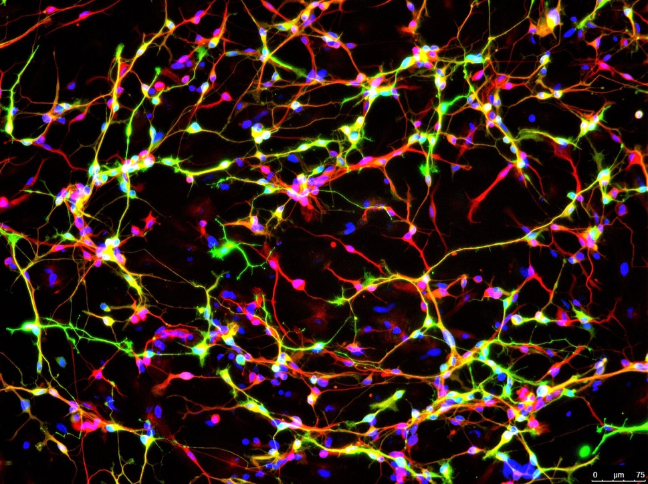
Background
Depression-like phenotypes have been linked to specific dopamine neurons
Investigated whether bidirectional control (inhibition or excitation) of specific forebrain dopamine neurons can modulate depression symptoms

Slide 58
Background
There is evidence linking the mesolimbic dopamine system with reward related behavior
Midbrain dopamine neurons could have causal role

Slide 59
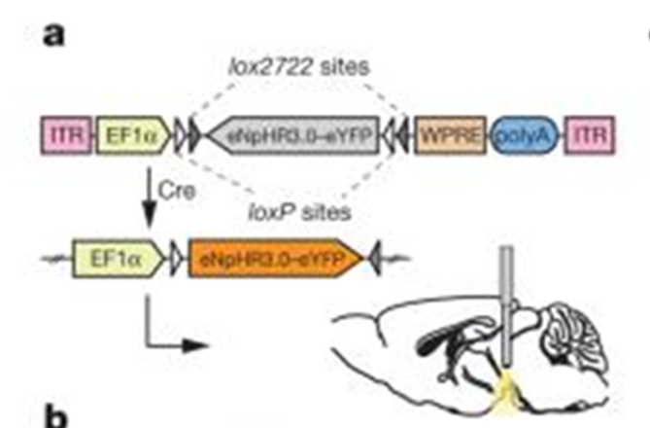
Methods
Mice and rats were the subjects of this experiment
Virus preparation
ChR2eYFP (mice)
ChR2(H134R)-eYFP (rats only)
eNpHR3.0-eYFP (mice)
eYFP alone (all)
Virus inserted between incompatible loxP and lox2722 sites

Slide 60
Methods
Animals were implanted with an implantable fiber optic light guide (IFL)
A bilateral cannula was also implanted .5 mm above NAc
Glutamate and dopamine receptor antagonists were infused through bilateral cannula
An enhanced halorhodopsin that hyperpolarized neurons upon illumination was used
In VTA dopamine neurons

Slide 61
Methods
Depressive behavior tests were used
Forced Swim Test
Tail-Suspension Test
Sucrose Preference Test
Time-Intensive Chronic Mild Stress (CMS) paradigm
VTA dopamine neurons were phasically activated
Via channelrhodopsin-2 (ChR2)
Induced excitation with light

Slide 62
Methods
Four groups of mice were used
eYFP-transduced and exposed to CMS
ChR2-transduced and exposed to low stress
ChR2-transduced and exposed to CMS
eYFP-transduced and not exposed to CMS
TH:Cre rats were used to measure expressed escape behaviors while wearing an electrophysiological recording headstage
Recorded NAc activity
Notes:
Animals were examined during baseline (light off), phasic illumination (light on), and post illumination (light off) epochs
a, Experimental groups.

Slide 63
Results
Notes:
c, Photoinhibition of VTA dopamine neurons acutely reduces escape-related behaviour. Two-way ANOVA demonstrates the group-by-light epoch interaction (interaction of the experimental-group factor and light-condition factor in the test), Bonferroni post-hoc test shows reduced struggling in the eNpHR3.0 group relative to the eYFP group,

Slide 64
Results
Notes:
d, Inhibition of VTA dopamine neurons does not produce a significant difference in open-field locomotion; two-way ANOVA did not demonstrate a significant group-by-light epoch interaction,
e, Schematic and results of the 90-min sucrose-preference test. Photoinhibition of VTA dopamine neurons acutely reduces sucrose preference; two-way ANOVA revealed that opsin expression has a significant effect, Bonferroni post-hoc test revealed significant differences between groups only in the light-on epoch

Slide 65
Results
Notes:
c, Phasic illumination of VTA dopamine neurons rescues stress-induced reduction in struggling on TST in ChR2 CMS but not eYFP CMS. Two-way ANOVA revealed a significant group-by-light epoch interaction and a significant influence of experimental condition on performance as revealed by one-way ANOVA

Slide 66
Results
Notes:
d, Illumination parameters, as used in the TST, did not change locomotor activity in the open field, with no significant group-by-epoch interaction in two-way ANOVA and no detectable differences revealed by Bonferroni post-hoc tests on the same timescale.
e, Phasic activation of VTA dopamine neurons rescued the stress-induced decrease in sucrose preference in ChR2 CMS, but not eYFP CMS mice; one-way ANOVA, Dunn’s post-hoc test comparing baseline to light-on epoch. Two-way ANOVA revealed a significant group-by-light epoch interaction, and a significant influence of experimental condition on performance was revealed by one-way ANOVA.

Slide 67
Results
Notes:
c, Light-induced modulation of swimming; phasic illumination of ChR2-expressing VTA dopamine neurons increases escape behaviour of TH::Cre rats in FST. Thick red line, mean kick rate; dotted lines
d, Phasic illumination of ChR2-expressing VTA dopamine neurons increases kick rate in FST but not ambulation rate in OFT

Slide 68
Results
Animals subjected to CMS had reduced escape behavior during Tail-Suspension Test
The ChR2-CMS group showed a robust increase in escape behavior upon illumination
Phasic illumination of VTA dopamine neurons in ChR2-CMS mice reversed CMS-induced depressive behavior

Slide 69
Results
Animals subjected to Sucrose Preference Test exhibited CMS-induced decrease in sucrose preference
eYFP and ChR2-CMS mice specifically
Phasic activation of VTA dopamine neurons acutely reversed CMS-induced anhedonic behavior in ChR2-CMS mice
Dopamine receptor blockage in the NAc
Reduced struggling in FST and TST
Indicative of despair

Slide 70
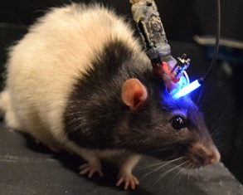
Results
ChR2-CMS Rats with electrophysiological headstage subjected to FST showed a decrease in escape behavior
Illumination of VTA dopamine neurons led to an increase in escape behavior in ChR2-CMS rats
Robust increase in kick frequency recorded

Slide 71
Discussion
VTA dopamine neurons can rapidly induce or ameliorate depressive behaviors
VTA has many downstream projection regions throughout the brain
Which regions are implicated remain unclear
NAc seems a reasonable choice
NAc receives dopaminergic innervation involved in the reward system
Dopaminergic innervation of NAc from VTA is important for maintaining motivated escape behavior

Slide 72
Discussion
Selective inhibition of VTA dopamine neurons acutely produces measurable depressive behavior as well as anhedonia
Phasic activation of VTA dopamine neurons acutely reverses CMS-induced depressive phenotype
Suggests that some behaviors may be modulated by dopaminergic tone
As more NAc neurons showed phasic responses to VTA dopamine activation, the greater the escape response

Slide 73
Discussion
VTA dopamine firing accompanies anticipation
Reward seeking behavior

Slide 74
Conclusion
Chronic mild stress can sufficiently induce depressive-like phenotypes
Bidirectional (inhibition or excitation) of specific midbrain dopamine neurons modulates (induces or relieves) CMS induced depressive phenotype
Processes implicating depressive symptomology may alter neural encoding of action in mesolimbic dopamine system
At VTA and downstream at NAc

Slide 75
Bringing it all together
Notes:
The mesolimbic dopamine system is involved in the reward system of the brain
Reward motivation
Compulsion
Perseverance
Dysfunction in this system could be linked with the depressive phenotype
Anhedonia (lack of pleasure seeking suggests reward motivation and anticipation dysfunction)
Impulsivity (lack of impulse inhibition suggests underlying problems in the PFC)
As the PFC deals with emotional regulation and valuation during decision making
Lack of desire to perform tasks once found enjoyable- Less desire to go on (persevere)

Slide 76
Bringing it all together
Rats fed REF diet showed increased impulsivity and decreased sustained attention
Cognitive control in sustained attention tasks involves mesolimbic dopamine projections to the PFC
ACh spiking in frontal cortex→ maintain sensory input and planned response
Altered ACh in VTA can have impact on VTA dopaminergic tone

Slide 77
Bringing it all together
VTA mAChR blockade decreases mesolimbic dopamine burst firing patterns
Anti-depressive effects
VTA dopaminergic tone- alteration of phasic tone may be implicated in MDD and GAD

Slide 78
So is there a link between obesity and depression?
Notes:
Potentially. Obesity might not be directly implicated. More so a traditional Western diet consisting a highly processed and refined foods
Chronic consumption could lead to alteration of cholinergic tone in VTA, which could alter dopaminergic tone
Thus inducing a depressive like phenotype
Specifically impulsivity, lack of motivation, and shortened attention span

Slide 79
Thanks for listening!
Any questions/comments?

